Slide 1
Compiler project

Slide 2
About Project
We have created our own Python IDE.
In this one can write any type of python code.
It will display the errors like syntax error, semantic error, etc
We have used python for creating this IDE.
For GUI, we have used Tkinter (Python based UI designing tool).

Slide 3
What is Compilers???
In computing, a compiler is a computer program that translates computer code written in one programming language (the source language) into another language (the target language).
The name "compiler" is primarily used for programs that translate source code from a high-level programming language to a lower level language (e.g., assembly language, object code, or machine code) to create an executable program.

Slide 4
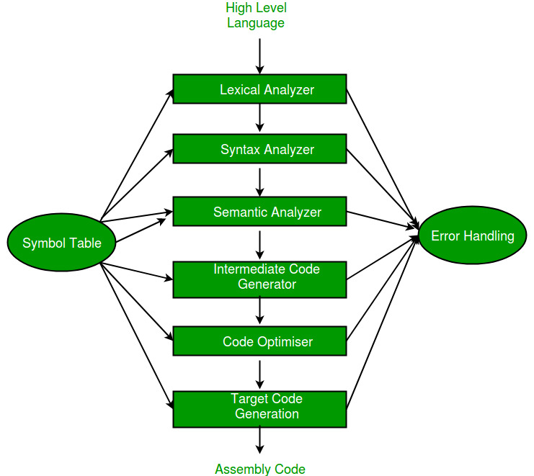
The phases of a compiler are:

Slide 5
The Phases of a compiler are:
Lexical Analyzer : Lexical Analysis is the first phase when compiler scans the source code. This process can be left to right, character by character, and group these characters into tokens.
Syntax Analyzer : Syntax analysis is all about discovering structure in code. It determines whether or not a text follows the expected format. Syntax analysis is based on the rules based on the specific programing language by constructing the parse tree with the help of tokens.

Slide 6
The Phases of a compiler are:
Semantic Analyzer : Semantic analysis checks the semantic consistency of the code. It uses the syntax tree of the previous phase along with the symbol table to verify that the given source code is semantically consistent. It also checks whether the code is conveying an appropriate meaning.
Intermediate Code Generator : Once the semantic analysis phase is over the compiler, generates intermediate code for the target machine. It represents a program for some abstract machine.

Slide 7
The Phases of a compiler are:
Code Optimiser : The next phase of is code optimization or Intermediate code. This phase removes unnecessary code line and arranges the sequence of statements to speed up the execution of the program without wasting resources. The main goal of this phase is to improve on the intermediate code to generate a code that runs faster and occupies less space.
Target Code Generation : Code generation is the last and final phase of a compiler. It gets inputs from code optimization phases and produces the page code or object code as a result. The objective of this phase is to allocate storage and generate relocatable machine code.

Slide 8
How this Project Work???
After running code...
Write your own program on our IDE.
You'll have to save it first and after that only it will run else it will give you an error in the form of message.
After saving program now you can run the code.
If errors are not available then you'll be able to see the output of your own program else you'll see an error.
If you want to edit any python code you can edit it.
So this is the IDE that can be used to write or edit a python program.

Slide 9
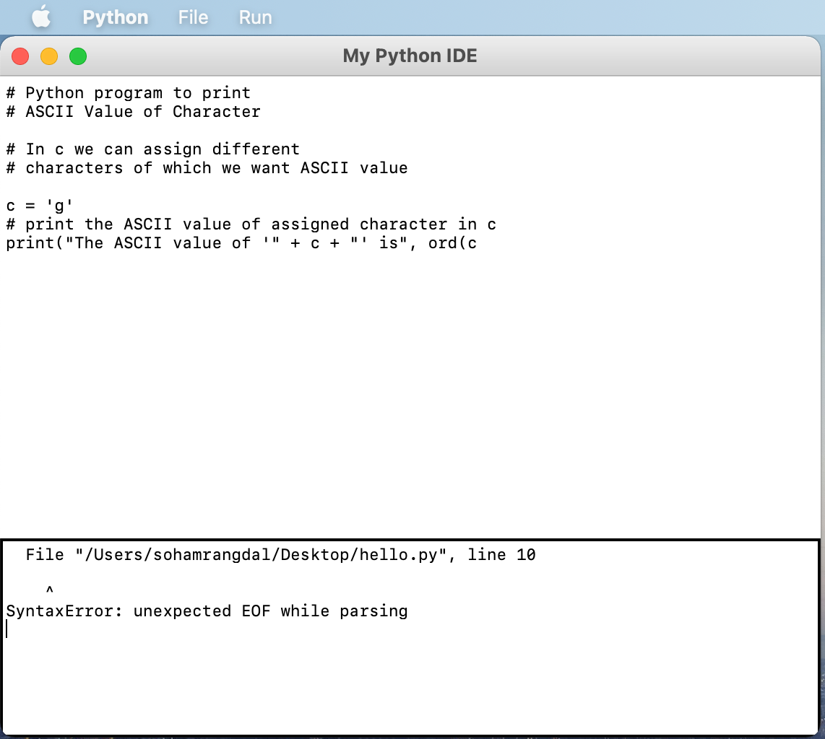
Screenshots
Program gives an error after
running your own python code.
Syntax Error

Slide 10
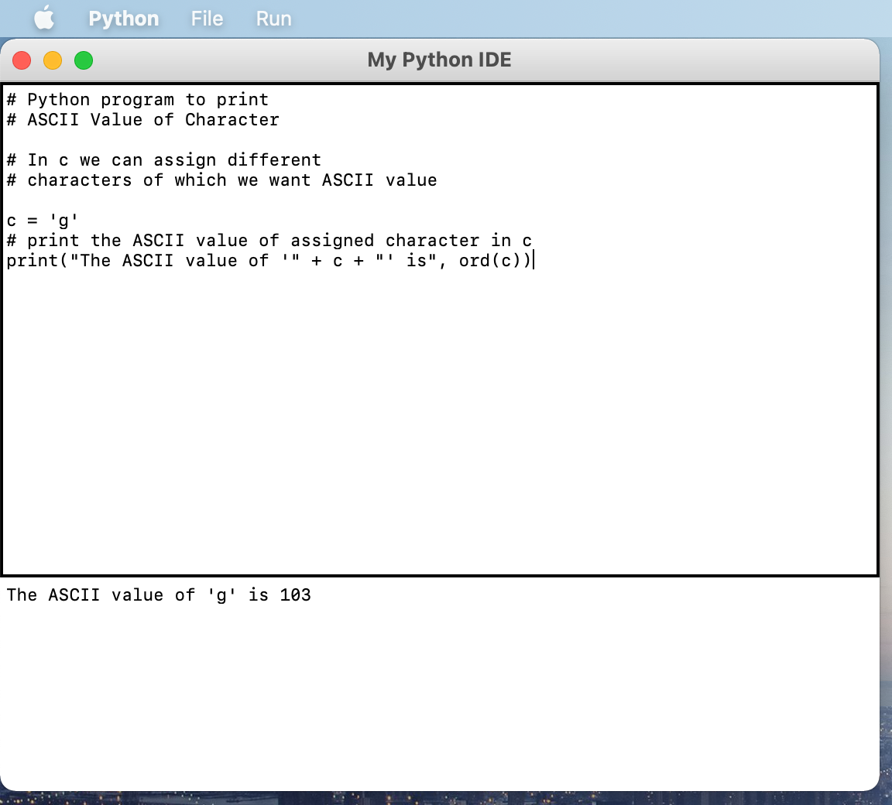
Screenshots
IDE showing an output of the
written code
Output of a program written on this IDE.
Output of the written program

Slide 11
Thank You

